Slide 1
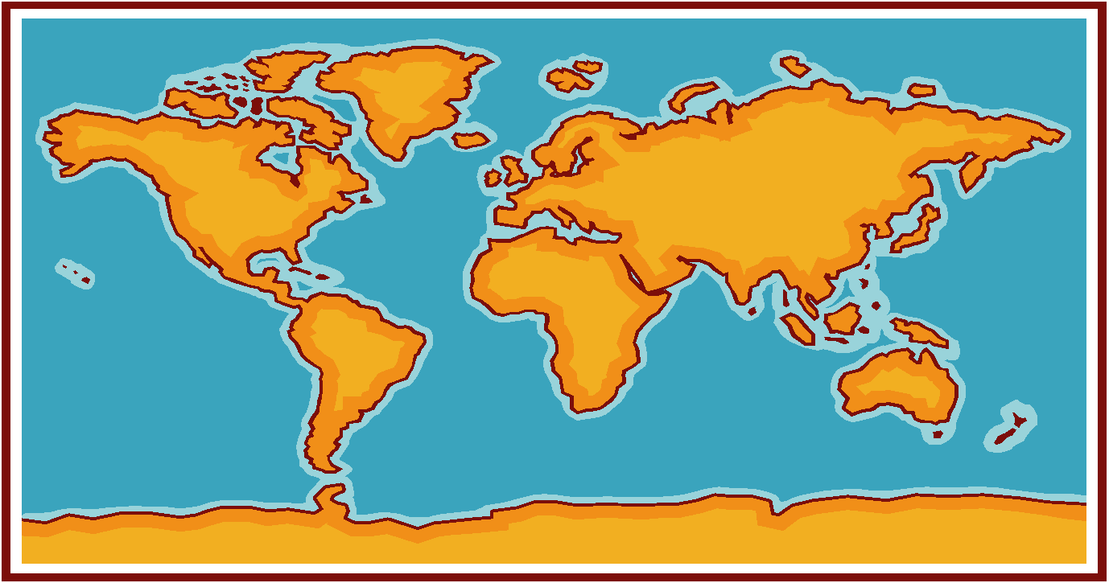
Oceans
Characteristics
Features
Life Forms

Slide 2
The World’s Oceans
An ocean is a large body of saltwater that covers around 70% of the Earth’s surface.
The oceans contain 97% of the earth’s water.
Oceanographers are scientists who study the ocean and its processes.

Slide 3
Oceans
The oceans are the Atlantic, Pacific, Indian, and Arctic.
The Pacific Ocean is the largest ocean.
The area and volume of the Pacific Ocean are greater than the Atlantic and Indian combined.

Slide 4
Meet an Oceanographer
https://www.youtube.com/watch?v=b9CvNvGt3QU

Slide 5
Importance of Oceans
Oceans regulate Earth’s temperature and climate.
Oceans provide a place for many organisms to live.

Slide 6
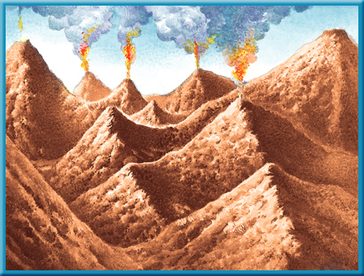
How were the oceans formed?
When Earth was still a young planet, many active volcanoes existed. As they erupted, lava, ash, and gases were released from deep within the Earth.
One of these
gases was
water vapor.

Slide 7
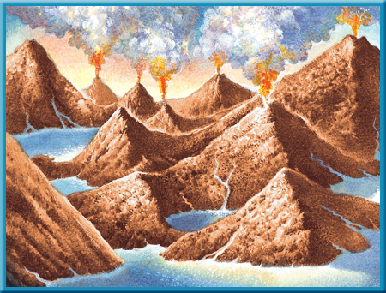
Formation of Oceans
Over millions of years, the water vapor cooled enough to condense and form clouds. Then torrential rains began to fall from the clouds.
Eventually, much
of the land was
covered by
water that formed

Slide 8
Seas
A sea is one of the largest bodies of salt water, less than an ocean, found on the earth’s surface.
The Mediterranean, Arctic and Black Sea are really part of the Atlantic Ocean.

Slide 9
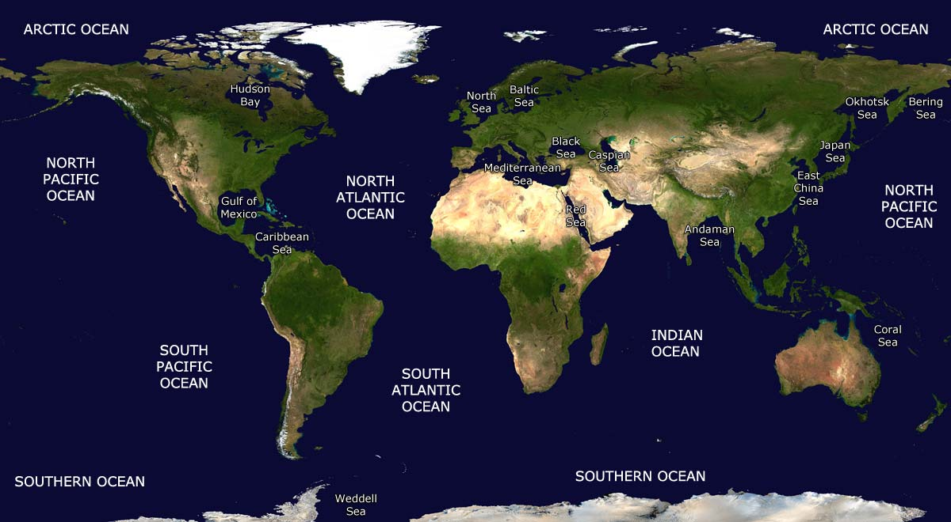

Slide 10
Properties of Ocean Water
Ocean water is a mixture of gases and solids dissolved in pure water.
Oceanographers believe oceans contain all the natural elements on Earth.
85 of 90 have been found in the ocean.

Slide 11
Major Elements in the Ocean
Ocean water is 96% pure water.
Chlorine (1.9) and sodium (1.1) make up the next largest concentration of elements.
Sodium chloride is table salt.

Slide 12
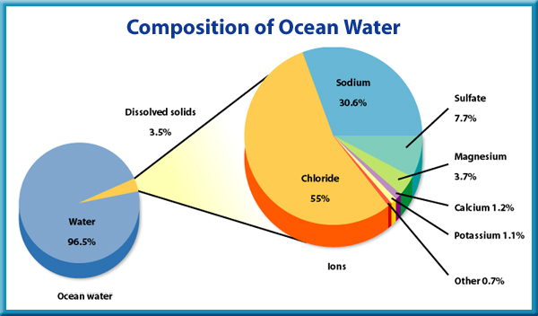
Salinity
Salinity describes the amount of dissolved salt in the ocean.
Salinity is expressed in parts per thousand.

Slide 13
Gases in Ocean Water
The most abundant gases in ocean water are nitrogen, carbon dioxide and oxygen.
The amounts of these elements vary with depth. They are more abundant at the ocean’s surface where sunlight causes more plant life.

Slide 14
Temperature of Ocean Water
Warm water holds less dissolved gas than cold water.
When ocean water is cold, like in polar regions, it sinks and carries oxygen rich water to the ocean depths.
As a result, fish and other animals can live in deep parts of the ocean.

Slide 15
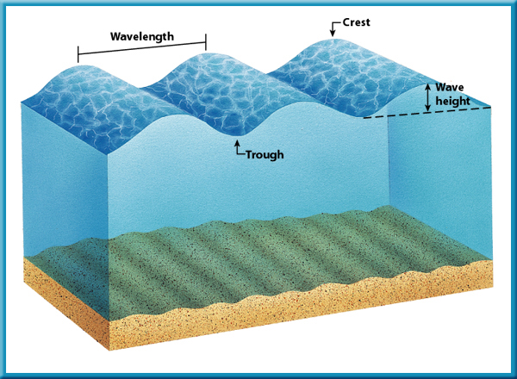
Waves
A wave in water is a rhythmic movement that carries energy through the water.
Waves are caused by high winds blowing on top of the water.

Slide 16
Tides
Throughout a day, the water level at the ocean’s edge changes. This rise and fall in sea level is called a tide.
A tide is a giant wave that can be thousands of kilometers long but only 1 m to 2 m high in the open ocean.
Tides are created by the gravitational attraction of Earth and the Moon and of Earth and the Sun.

Slide 17
Tides
Tides are created by the gravitational attraction of Earth and the Moon and of Earth and the Sun.

Slide 18
Movement of Water
Upwelling is the upward movement of cold water from the ocean depths.

Slide 19
Upwelling
Upwelling brings up tiny ocean organisms, minerals, and other nutrients from the deeper layers of the water; without upwelling the surface of the ocean would be nutrient deficient.

Slide 20
El Nino
El Nino is an abnormal climate event that occurs every 2-7 years in the Pacific Ocean, causing changes in the winds, currents, and weather patterns.

Slide 21
El Nino
El Nino interrupts up the pattern of upwelling.
Without nutrients provided by upwelling, fish and other organisms cannot find food.
Fish and other organisms die and weather patterns are disturbed.

Slide 22
The Ocean Floor
The ocean floor has higher mountains, deeper canyons, and larger flatter plains.
Earthquakes occur more often.
The rocks are very different.
The crust is thinner.

Slide 23
Continental Shelf
The continental shelf is the gradually sloping end of a continent that extends under the ocean.
The ocean covering the continental shelf can be as deep as 350 m.
Large mineral, oil and natural gas deposits are found here.

Slide 24
Continental Slope
At the edge of the continental shelf, the ocean floor plunges steeply 4 to 5 kilometers.
The continental slope extends from the outer edge of the continental shelf down to the ocean floor.

Slide 26
Abyssal Plains
Large, flat areas on the ocean floor are called abyssal plains.
The abyssal plains are larger in the Atlantic and Indian than in the Pacific due to the deposition of sediments by large rivers.
The Pacific Ocean has large cracks that trap sediments and result in smaller abyssal plains.

Slide 27
Abyssal Plains
Abyssal plains are close to the continent and are made of mud, sand and silt.
Farther out on the abyssal plains, some of them contain the remains of tiny organisms that form ooze.
Where ocean life is not abundant, the floor of the ocean is covered with red clay.

Slide 28
Seamounts and Guyots
Seamounts are underwater volcanic mountains that rise more than 100 meters above the ocean floor. Most have been found in the Pacific Ocean.
Some seamounts reach above the surface of the water to form islands, like the Azores in the Atlantic and the Hawaiian islands in the Pacific.
Guyots are flat-topped seamounts.

Slide 29
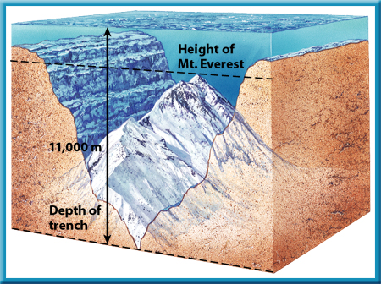
Trenches
Trenches are the deepest parts of the ocean found along the edge of the ocean floor.
The Mariana Trench in the Pacific Ocean contains the deepest spot (1100 meters) on Earth known as Challenger Deep.

Slide 30
Mid-ocean Ridges
A mid-ocean ridge is the area in an ocean basin where new ocean floor is formed.
The mid-ocean ridges form an almost continuous mountain belt that extends from the Arctic Ocean down through the middle of the Atlantic Ocean around Africa into the Indian Ocean and across the Pacific Ocean.
In the Atlantic it is called the mid-Atlantic Ridge and in the Pacific, the Pacific-Antarctica Ridge.

Slide 31
Ocean Life Zones
The plant and animal life in the ocean is affected by several factors.
One factor is the amount of sunlight that penetrates the ocean.
Another factor is the temperature of the ocean water.
Water pressure is also a factor.

Slide 32
Major Groups of Ocean Life
Plants and animals in the ocean are classified into three major groups based on their habits and the depth of the water in which they live.
The three major groups are plankton, nekton and benthos.

Slide 33
Plankton
Plankton float at or near the surface where sunlight can penetrate.
Most of the plankton are very small, such as algae.
These organisms drift with the currents or tides.
Plankton are the main food for many larger organisms. They account for most of the organisms in the ocean.

Slide 34
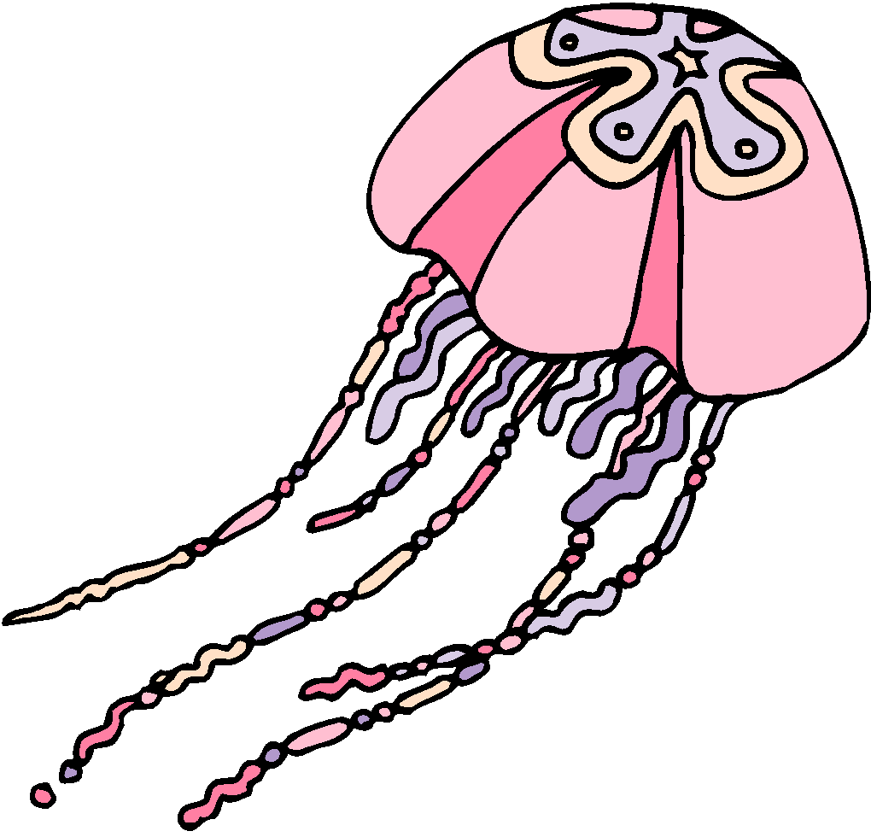
Plankton
Jellyfish, which float on the ocean surface, is one example of plankton.

Slide 35
Nekton
Whales, seals, dolphins, squid octopuses, barracuda and other fish are all nekton.
Nekton are free-swimming organisms that feed on other nekton as well as on plankton.
Many have adaptations enabling them to function at depths that have great pressure and no light.

Slide 36
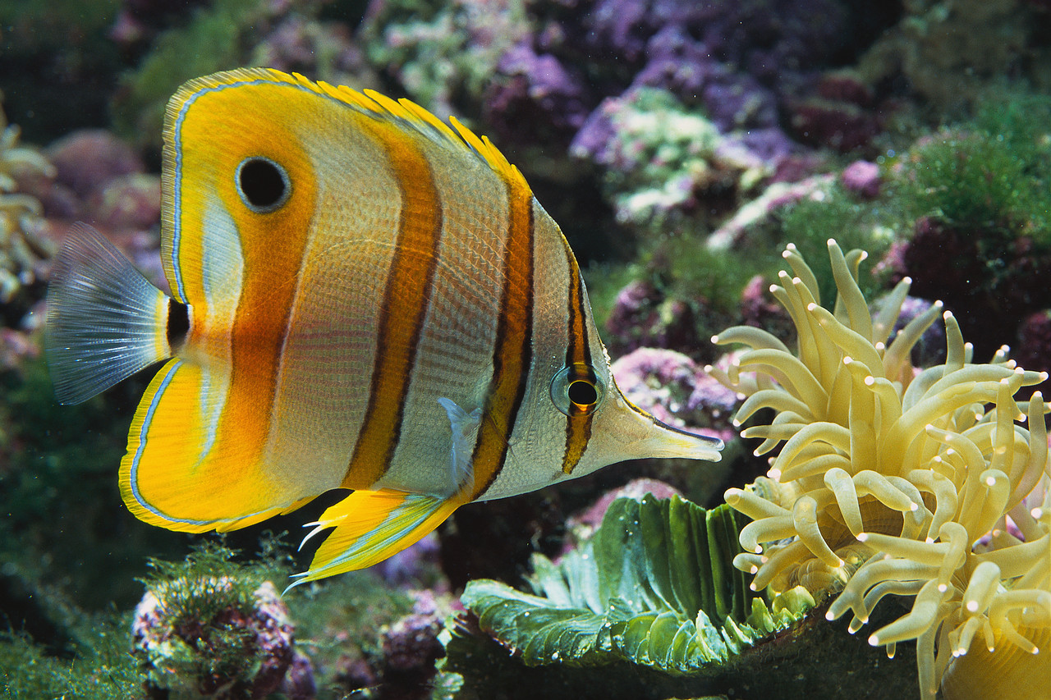
Nekton
This beautifully colored fish is classified as nekton.

Slide 37
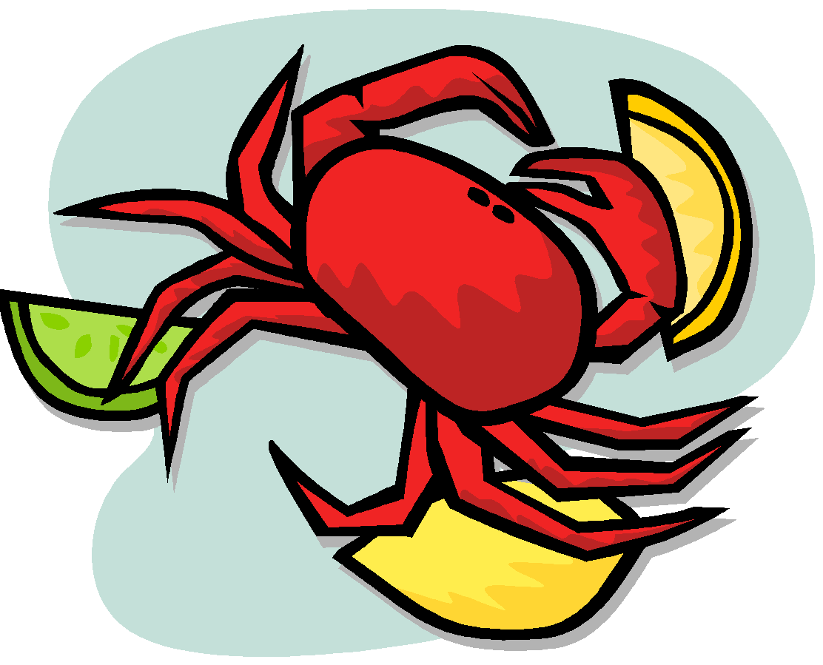
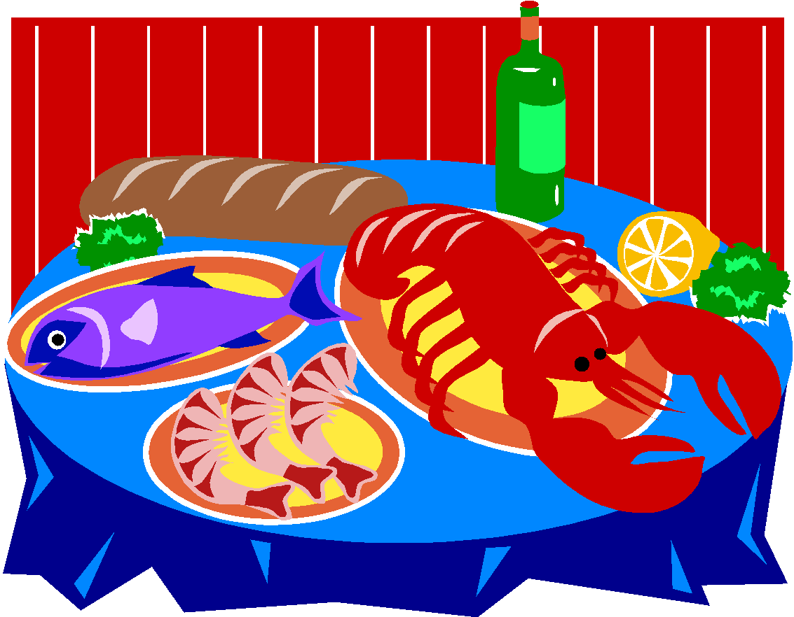
Benthos
Organisms that live on the ocean floor are benthos.
Crabs, and lobster are just a few examples of benthos.
The deep bottom environments are sparsely populated with benthos.
Some benthos are plants that live on the ocean floor in shallow waters where sun can penetrate.

Slide 38
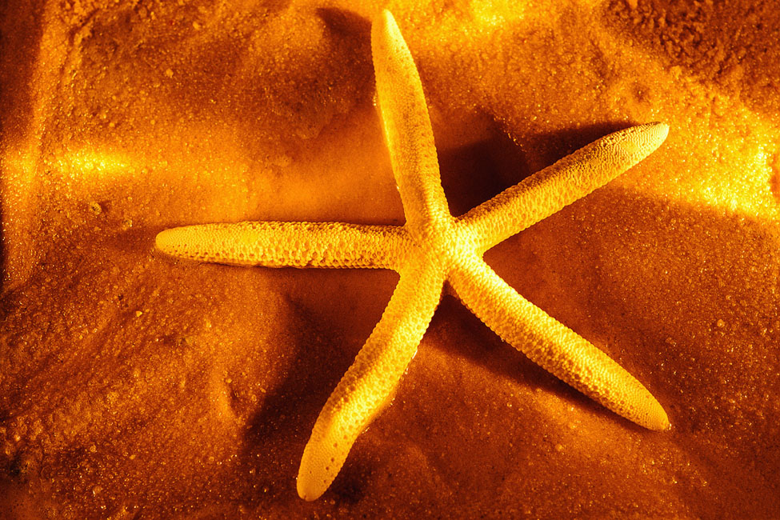
Benthos
A starfish is an example of benthos.

