Slide 1
Composition of the Earth

Slide 2
Composition of the Earth
Matter and change
Minerals
Igneous Rocks
Sedimentary and Metamorphic Rocks

Slide 3
This unit will be called: Matter and Change
What is Earth made up of?

Slide 4
Earth is made of Elements
32% iron, 30% oxygen, 15% silicon, 14% magnesium, 3% sulfur, 2% nickel as well as calcium, aluminum and various trace elements.
Oxygen and Silicon are the most abundant elements on Earth.

Slide 5
Camuy Cave Formation
Notes:
Largest cave in the western hemisphere, up to 60 m tall and more than a kilometer long. Found in Northern Puerto Rico.
This view shows the opening of a sinkhole
Questions for students:
-What types of geologic events could have resulted in the present condition of the caves?
-Do you see any evidence of volcanic activity?
-What kind of materials are the rocks made of?

Slide 6
Camuy Caves
The Camuy river once traveled above ground but it sank underground and now runs through the cave system and flows directly to the atlantic ocean. It is located in Puerto Rico.
The opening seen in the photo was caused by the river when it sank underground.

Slide 7
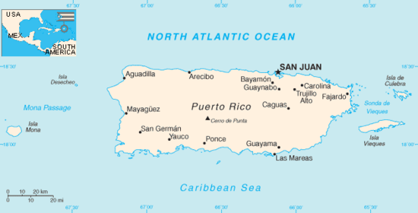

Slide 8
Planet Earth Video
https://www.youtube.com/watch?v=JGXi_9A__Vc

Slide 9
Elements
Each element is made up of a different number of protons.
Elements can be organized using the periodic table

Slide 10
Periodic Table

Slide 11
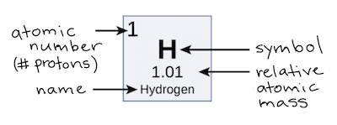

Slide 12
Element, atom, molecule, compound
element - a basic substance that can't be simplified (hydrogen, oxygen, gold, etc...)
atom - the smallest amount of an element
molecule - two or more atoms that are chemically joined together (H₂, O₂, H₂O, etc...)
compound - a molecule that contains more than one element (H₂O, C₆H₁₂O₆, etc...)

Slide 13
Videos
https://www.youtube.com/watch?v=I5H1SeepnaU
https://ed.ted.com/lessons/just-how-small-is-an-atom

Slide 14
Assignment
http://www.webquest.hawaii.edu/kukulu/webquests/webquest4/index.html
9batesscience.weebly.com/ can be used to access the web quest.

Slide 15
Example
Bridget Bates
Name: Nickel
Symbol: Ni
Atomic Number: 28
Atomic Mass: 58.6934

Slide 16
5. Nickel is a hard, corrosion resistant metal that can be electroplated onto other metals to form a protective coating. Adding nickel to glass gives it a green color. Nickel is used to manufacture wire, as well as some types of coins and batteries. Nickel is mixed with other metals to improve their strength and resistance to corrosion. Metals such as stainless steel has been created by mixing Nickel with other metals. Nickel is excellent for armor plates or vaults. Coins are 25% nickel and 75% copper. Nickel can also be combined with various other elements to form powerful magnets known as Alnico magnets.

Slide 17
When was Nickel discovered?
1751
2. Is Nickel harmful to human health?
Nickel is one of many carcinogenic metals known to be an environmental and occupational pollutant. The New York University School of Medicine warns that chronic exposure has been connected with increased risk of lung cancer, cardiovascular disease, neurological deficits, developmental deficits in childhood, and high blood pressure.

Slide 18
3. Why is Nickel toxic?
Having toxic metals in your body is like having sugar in your gas tank. It’s simply not built to process the material and severe mechanical problems are going to result.

Slide 19
Works Cited
http://education.jlab.org/
http://www.chemicalelements.com
http://www.chemicool.com
http://www.webelements.com
http://www.chem4kids.com/files/elem_intro.html (this site focuses on the first 18 elements
Answer reflection questions in your oblog or notebook.

Slide 20
What is Matter?
Matter is anything that has volume and mass. All matter is made up of substances called elements.
Matter can exist as elements, compounds, or mixtures.
An element is a substance that cannot be broken down by physical or chemical means.
E.g.-gold is still gold, whether it’s a gold brick, coins, or statue.

Slide 21
What is volume?
Volume is a measure of how much space an object takes up. For example two shoe boxes together have twice the volume of a single box, because they take up twice the amount of space.

Slide 22
Density
Density is a measure of mass per unit of volume.

Slide 23
What is mass?
Mass (symbolized m) is a dimensionless quantity representing the amount of matter in a particle or object. The standard unit of mass in the International System (SI) is the kilogram (kg). ... The mass of an object can be calculated if the force and the acceleration are known.

Slide 24
How do you calculate the mass?
Multiply the volume and density together. Multiply your two numbers together, and you'll know the mass of your object.

Slide 25
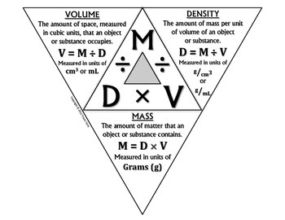

Slide 26
Let’s do an example together
A piece of aluminum has a volume of 6.0 cm3 and a density of 2.70 g/cm3. What is its mass?
Mass=6.0cm^3×2.70 g/1cm^3=16.2 g

Slide 27
Now you try!
Calculate the mass of 30.0 mL of methanol, if the density of methanol is 0.790 g/mL.

Slide 28
Mass=30.0mL×0.790 g/1mL=23.7 g

Slide 30
Newton’s Second Law
The net force on an object is equal to the mass of the object multiplied by the acceleration of the object.
https://www.youtube.com/watch?v=qu_P4lbmV_I

Slide 31
Mass Number
The sum of protons and neutrons is the mass number. Because electrons have little mass, they are not included in determining the mass number.
The atomic mass of an element is the average of the mass numbers of the isotopes of an element.
Also known as atomic weight!

Slide 32
Isotopes
Atoms of the same element that have the same number of protons but a different number of neutrons are called isotopes.
Ex- The element Chlorine has two isotopes: Cl-35 and Cl-37

Slide 33
Energy Levels
Electrons occupy areas called energy levels. Each energy level can hold only a limited number of electrons.
Innermost level- can hold only two electrons
Second energy level- can hold up to eight electrons
Third energy level- can hold up to 18 electrons
Fourth energy level- csn hold up to 32 electrons

Slide 34
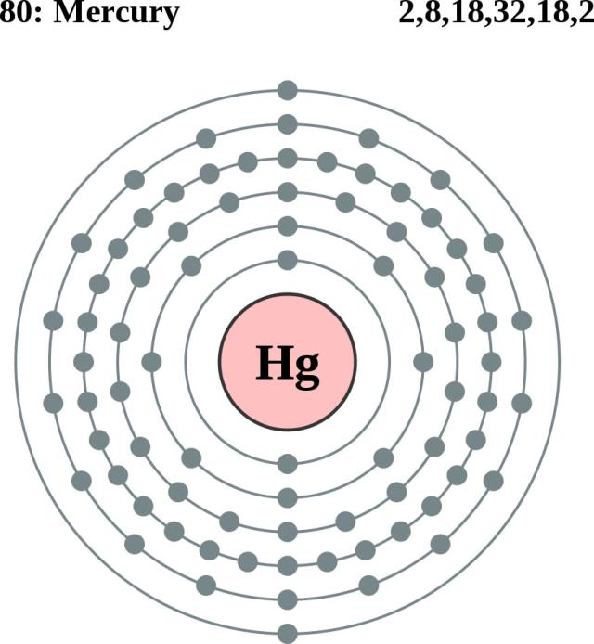

Slide 35
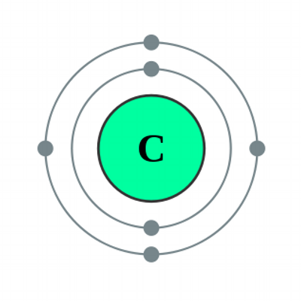

Slide 36
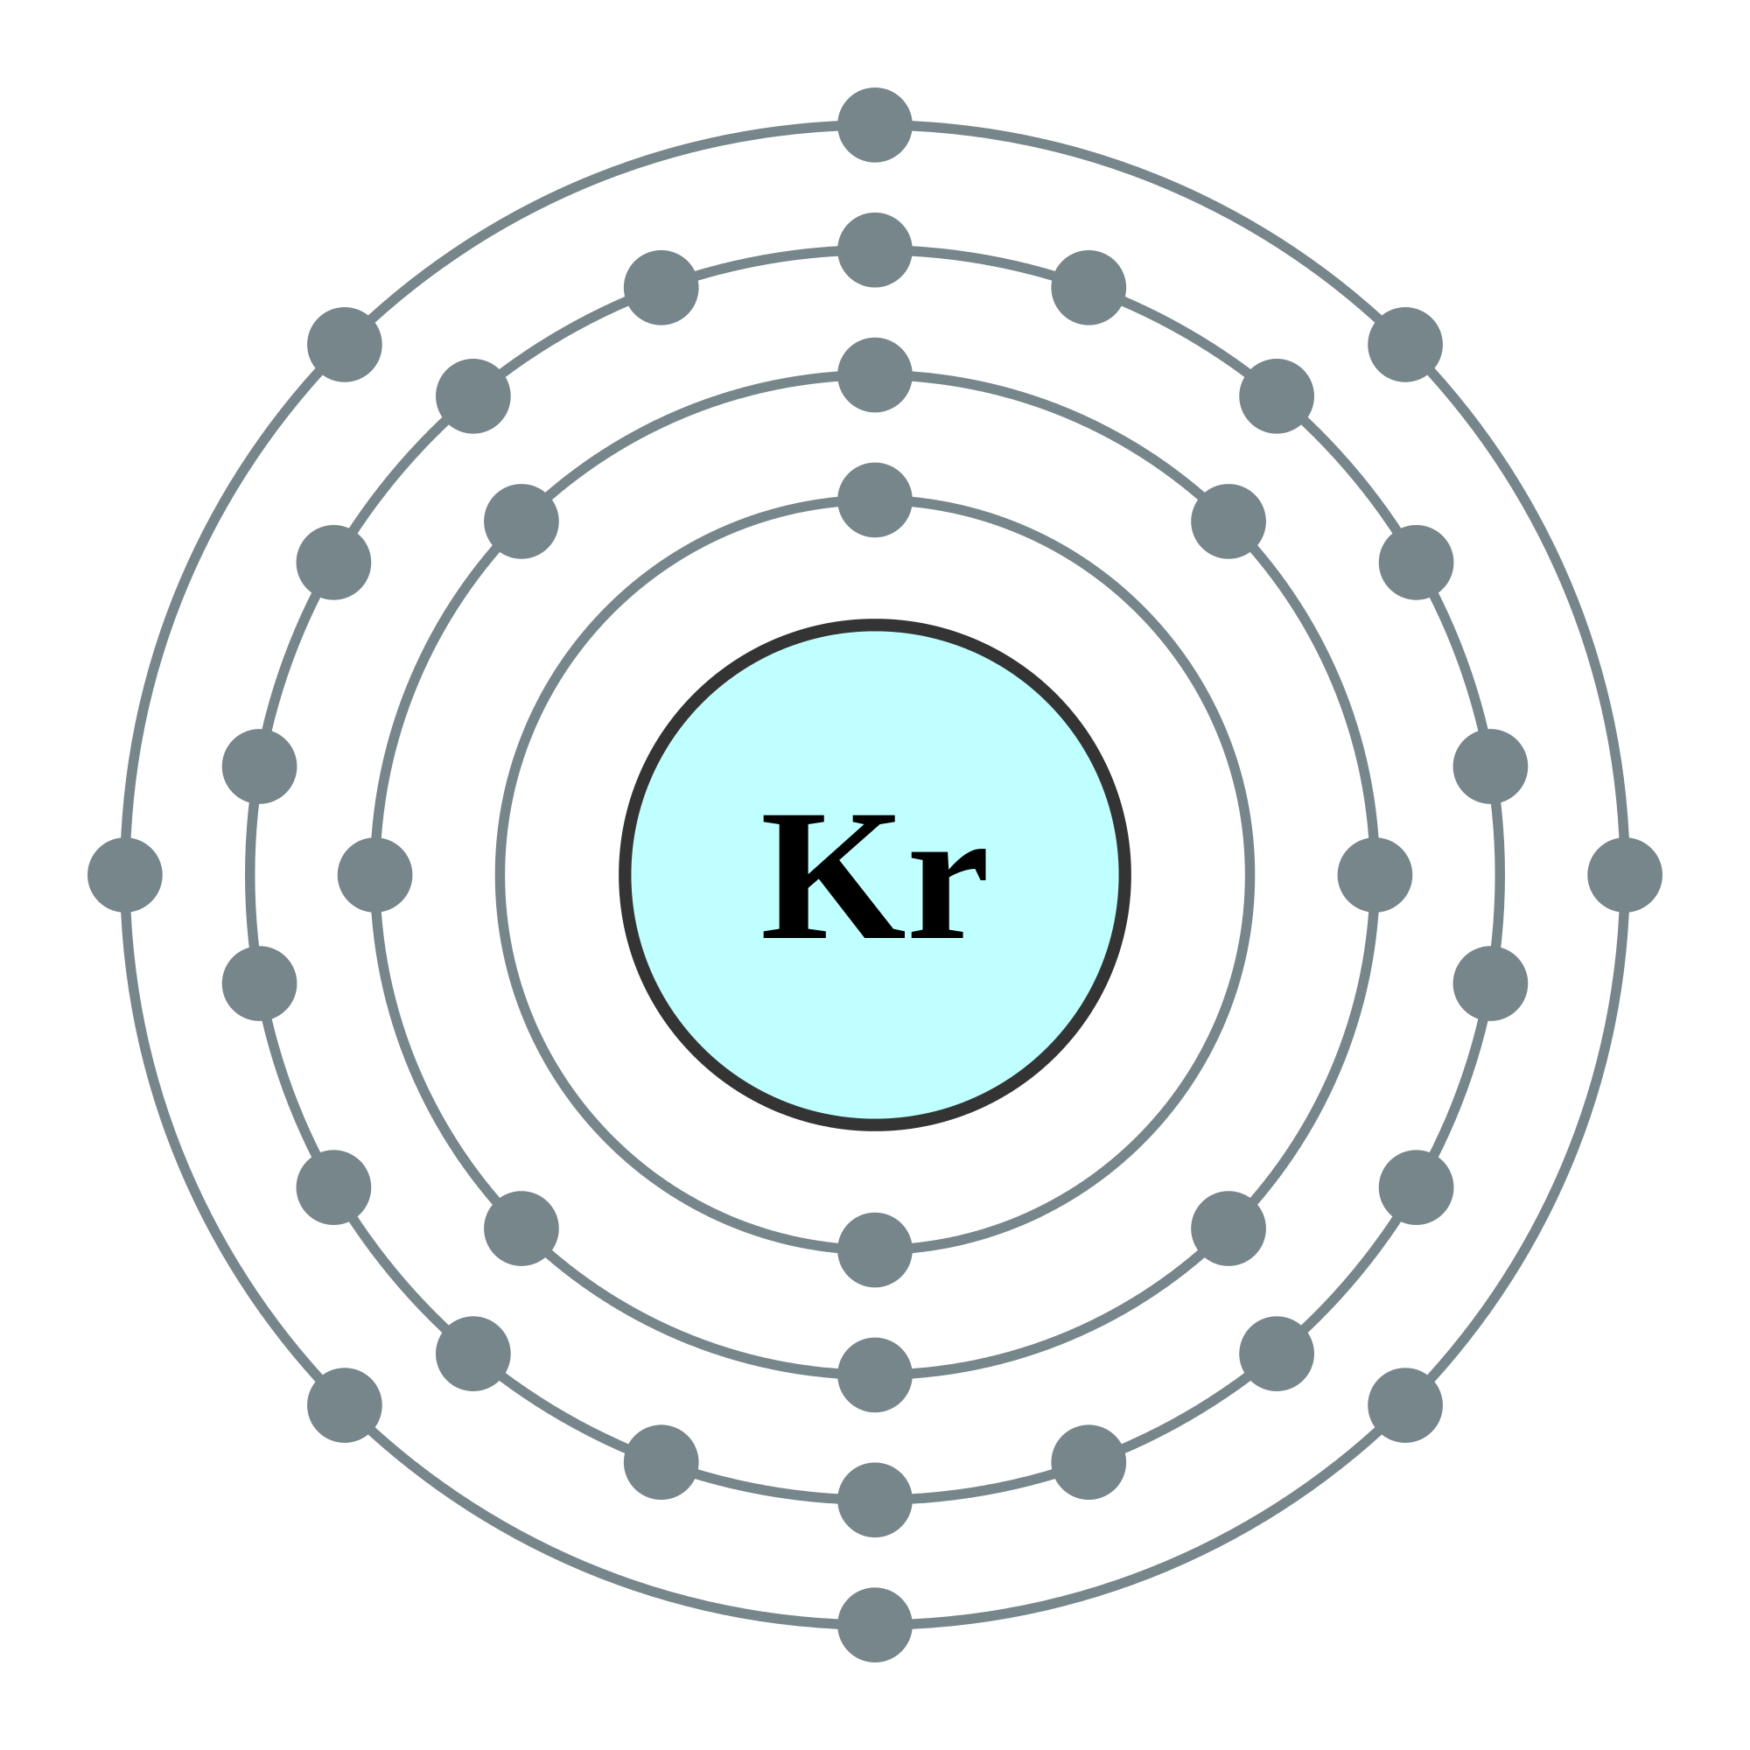

Slide 37
Valence Electrons
The electrons in the outermost energy level are called the valence electrons and these electrons determine the chemical behavior of the different elements.
Video about electrons:
https://www.youtube.com/watch?v=rcKilE9CdaA

Slide 38
Sodium and Potassium
On the left side of the periodic table, Sodium and potassium both have one valence electron
So, they both exhibit similar chemical behaviors.
Sodium and Potassium both are highly reactive metals, which means they combine easily with other elements.

Slide 39
Helium and Argon
On the right side of the periodic table, elements such as helium and argon have full outermost energy levels. Elements with full outermost energy levels filled are highly unreactive.
Ex- Argon has 8 electrons in the third energy level

Slide 40
Chemical Formula
Chemical formulas shows the symbols of the elements in the compound and the ratio of the elements to one another. If a substance contains more than one atom of a particular element, this quantity is indicated in chemical formulas using a subscript number after the chemical symbol.
Ex- H20

Slide 41
Chemical Bond
The force that holds together the elements in a compound.
Types of chemical bonds:
Covalent Bonds
Hydrogen Bond
Ionic Bond
Metallic Bond

Slide 42
Brainpop- Chemical Bonds
https://www.brainpop.com/science/matterandchemistry/chemicalbonds/

Slide 43
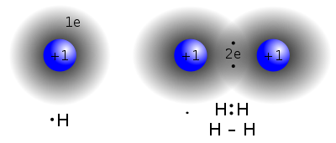
Covalent Bond
A covalent bond, also called a molecular bond, is a chemical bond that involves the sharing of electron pairs between atoms.

Slide 44
Hydrogen Bond
A type of chemical bond in which a hydrogen atom that has a covalent link with one of the electronegative atoms (F, N, O) forms an electrostatic link with another electronegative atom in the same or another molecule.

Slide 45
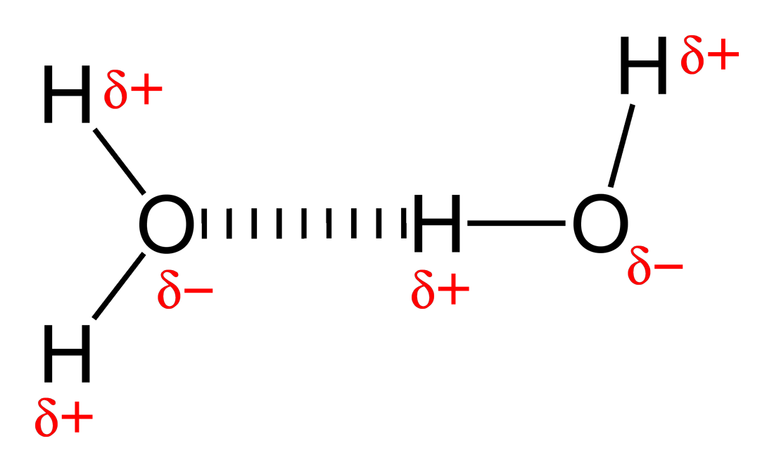

Slide 46
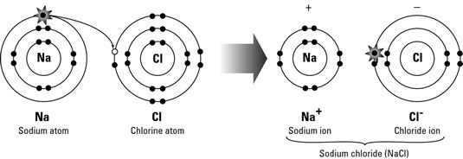
Ionic Bonds
Attractive force between two ions of opposite charge

Slide 47
Metallic Bond
Metallic bonding is the force of attraction between valence electrons and the metal atoms.

Slide 48
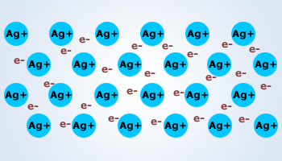

Slide 50
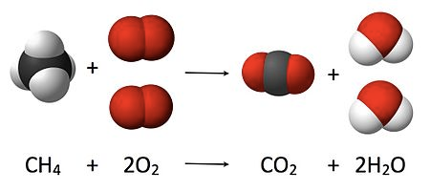
Chemical Reaction
The change of one or more substances into other substances are known as a chemical reaction.

Slide 51
Heterogenous mixture
A heterogeneous mixture is a mixture that composes of components that aren't uniform or they have localized regions that all have different properties.
For example, Salt and pepper, chocolate chip cookies, or a Twix™ candy bar, ... are all examples of heterogeneous mixtures, where substances are not mixed on a molecular level. Soda is a heterogeneous mixture (liquid solution) of H2O, C6H12O6, and a few other substances.

Slide 52
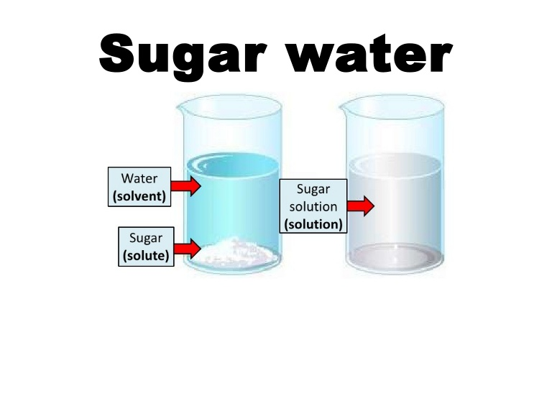
Homogenous mixture (solution)
A homogeneous mixture has the same uniform appearance and composition throughout.

Slide 53
Compounds and Mixtures
https://www.brainpop.com/science/matterandchemistry/compoundsandmixtures/

Slide 54
Acids and bases
An acid is a solution containing a substance that produces hydrogen ions in water. Often referred to as a proton donor.
A base is a substance that produces hydroxide ions in water.
Brainpop:
https://www.brainpop.com/science/matterandchemistry/acidsandbases/

Slide 55
pH Scale
The pH scale measures how acidic or basic a substance is. The pH scale ranges from 0 to 14. A pH of 7 is neutral.

Slide 56
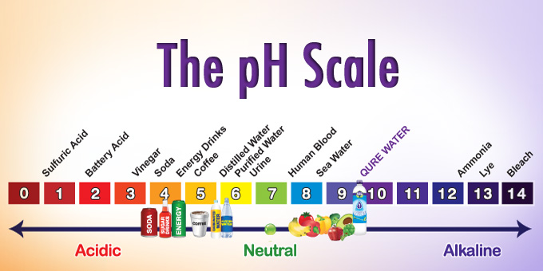

Slide 57
When a solution has more hydrogen ions (H+ ) it means it is more acidic. For example when an acid solution dissolves in water the balance of hydrogen and hydroxide changes so you end up with more hydrogen ions

Slide 58
When a solution has more hydroxide ions (OH-) it means it is more basic. In comparison to the last question the end result is reversed; when an acid solution dissolves in water the balance of hydrogen and hydroxide changes so you end up with more hydroxide ions

Slide 59
Facts about pH
The pH of blood is slightly alkaline with a pH of 7.4 (the physiological pH )
Plaque can create an acidic environment that can result in tooth decay.
Acid overload of the body (acidosis ), the most common form of acid base homeostasis is generally present when the pH falls below 7.35.
Alkaline foods are therefore much better for you.

Slide 60
Brainpop- pH Scale
https://www.brainpop.com/science/matterandchemistry/phscale/

Slide 61
Radioactivity
-The term was coined by Marie Curie
- Radioactive elements emit radiation which are harmful to humans.

