Slide 1
The Geologic Time Scale
Standard: Analyze evidence for geologic, climatic, environmental, and life form changes over time.

Slide 2
K.I.M. Sheets
Fill out the Vocab Terms on your K.I.M Sheet
Geology | Catastrophism | Absolute Dating
Geologic Time Scale | Uniformitarianism | Relative Dating

Slide 3
Studying Rock
“How old is Earth?”, “How does new rock form?”- Questions asked by scientists studying geology.
Geology is the scientific study of the origin, history, structure and processes of Earth.

Slide 4
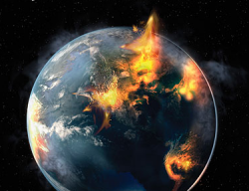
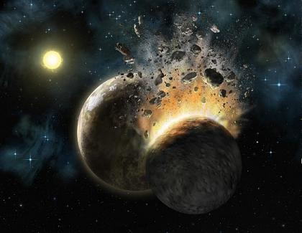
Changes Occur Suddenly:
Early scientists (100s to 1000s of years ago) used catastrophism to explain geologic change.
Did not understand the slower, gradual changes that were more difficult to see!

Slide 5
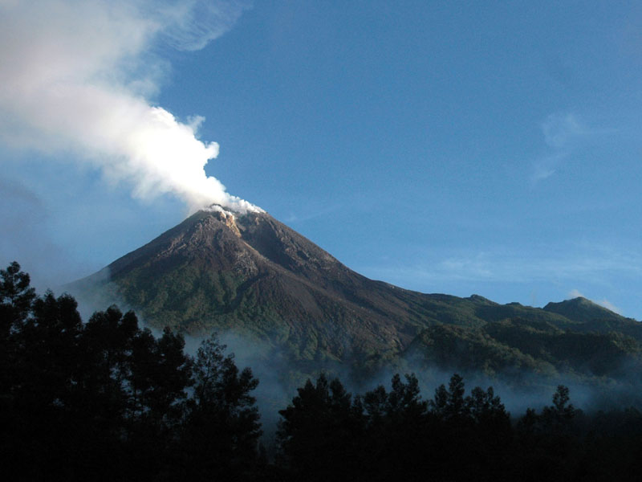
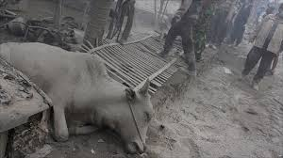
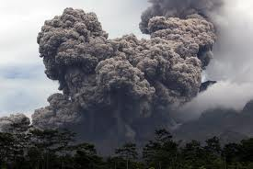
Catastrophism
In 2010, Merapi volcano in Indonesia erupted, releasing millions of cubic meters of ash, dust and gases, that fell 100s of miles away.
Catastrophism is the principle that states all geologic change occurs suddenly.

Slide 6
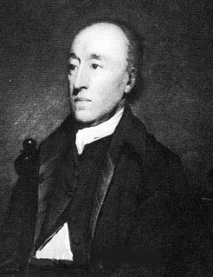
Changes Occur Gradually
250 yrs ago, Scottish farmer/scientist studied rock formations. Years of observation challenged catastrophism. (James Hutton)
Led to foundation of modern geology.

Slide 7
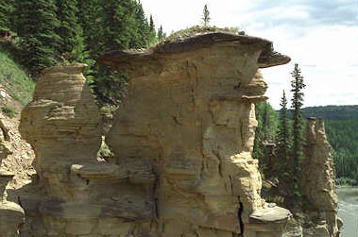
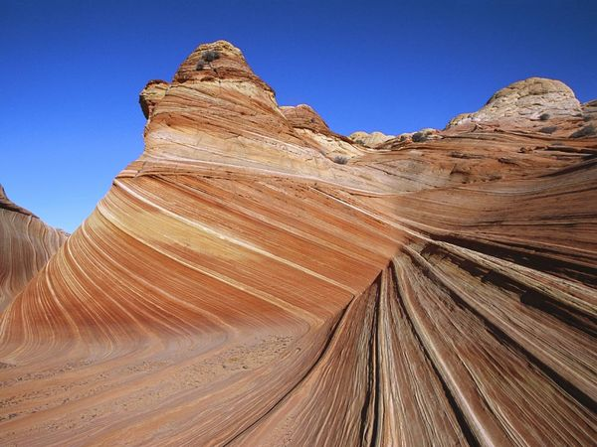
Uniformitarianism
Processes like erosion and deposition take long periods of time to observe change.
Uniformitarianism is the idea that the same geologic processes that shape Earth today have been at work throughout Earth’s history.

Slide 8
Modern Geology Today
Geologists now realize that changes occur both Catastrophically and Gradually.
While most geologic change is gradual, forces like earthquakes, floods, volcanic eruptions and asteroid impacts continue to cause sudden changes to the face of Earth.

Slide 9
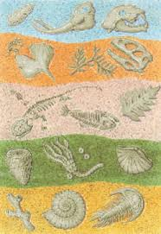
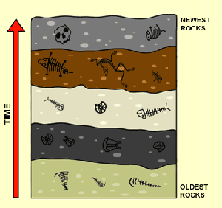
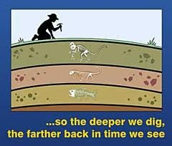
Relative Dating
Relative Dating is determining how old an object or event is by comparing the rock layer in which it was found.

Slide 10
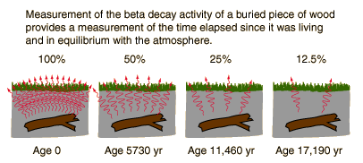
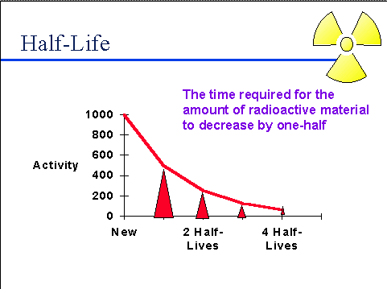
Absolute Dating
Determining the actual age of an event or object in years is called absolute dating.
Radioactive Decay
Radiocarbon Dating (only organic/45,000 yrs)
Potassium-Argon Dating (volcanic rock)
Uranium-Lead Dating (rocks-100 to billion yrs)
Half-life

Slide 11
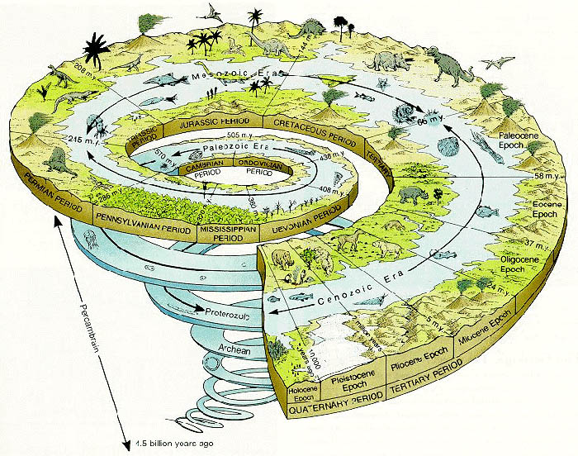
Geologic Time Scale
Earth is OLD, 4.6 Billion years old! How do we make sense of this vast time frame?
Geologists use the geologic time scale to organize Earth’s history.
The geologic time scale divides Earth’s history into intervals of time defined by major events or changes on Earth.

Slide 12
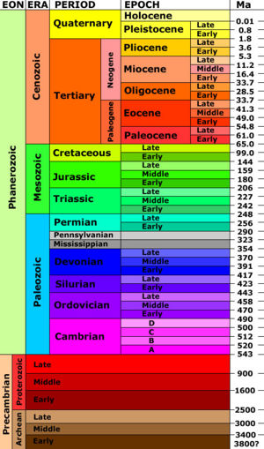
Divisions of Time
Largest unit of geologic time is an Eon.
Precambrian Time = 90% of Earth History
Eons divided into smaller groups called Era’s.
Paleozoic
Mesozoic
Cenozoic
Each Era is subdivided into Periods. Periods and divided into Epochs.

Slide 13
Divisions of Time (cont.)
Unlike divisions of time such as days or minutes, the geologic time scale has NO fixed lengths.
Many Divisions are based entirely on the fossil record.

Slide 14
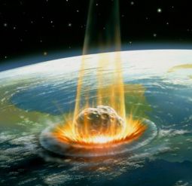
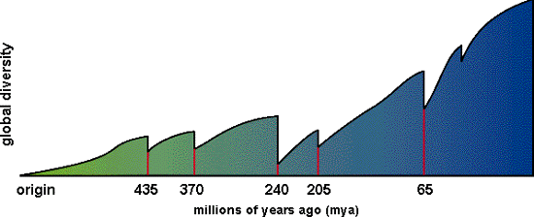
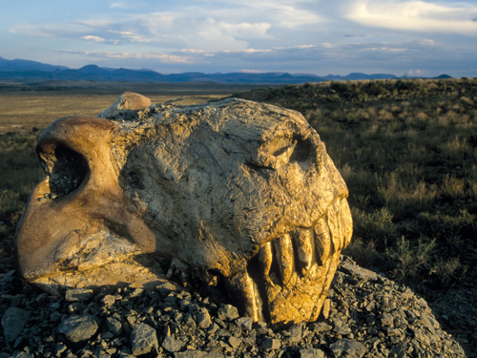
Divisions of Time (cont.)
There are 5 divisions of geologic time that have ended in large mass extinction events.
Organisms disappear from the fossil record.

Slide 15
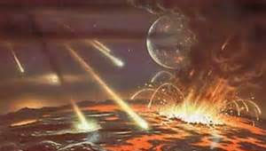
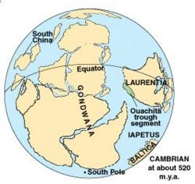
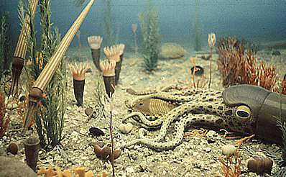
Events of Precambrian Time
Began with formation of Earth 4.6 billion years ago.
Continents began to form.
Atmosphere made mainly of gases released from volcanoes.
Water vapor fell and pooled to form first Oceans
Cyanobacteria, living in oceans, began releasing oxygen during photosynthesis.

Slide 16
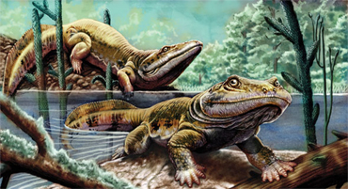
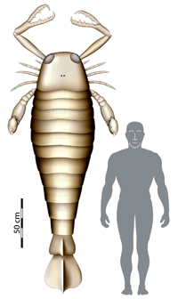
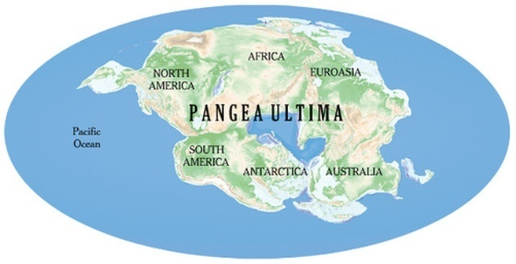
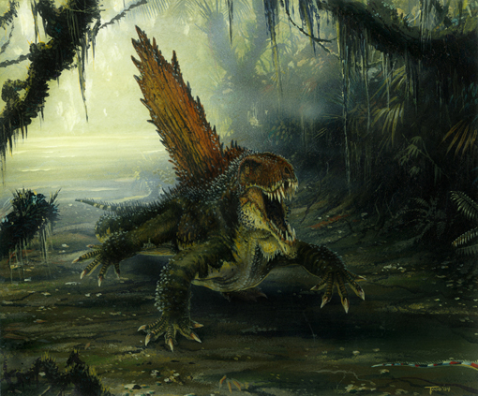
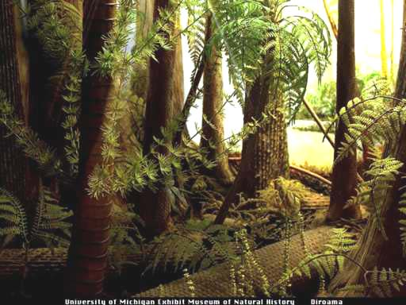
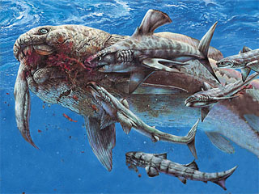
Events of the Paleozoic Era
Began 540 million years ago.
Formation of Pangaea begins
Life quickly began to colonize land
Cambrian “Explosion” leads to most major groups of organisms
Permian Extinction at end of Era wiped out 90-95% of marine life and 70% of land species

Slide 17
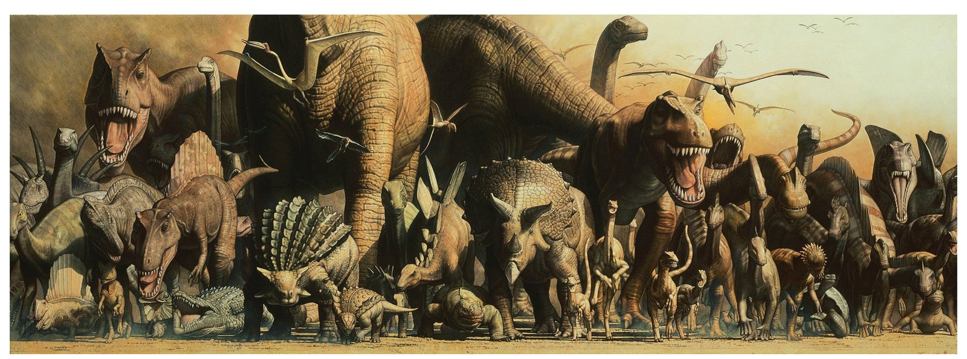
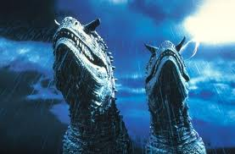
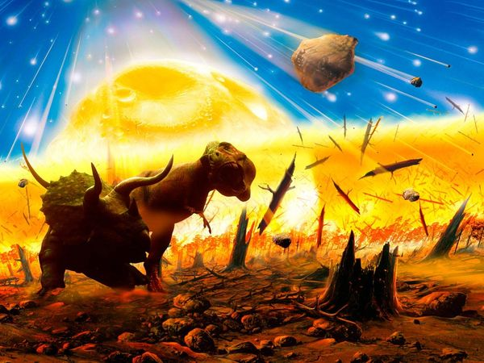
Events of the Mesozoic Era
Began about 250 millions years ago.
Pangaea breaks apart
Atlantic Ocean opens up between America and Africa
Sea levels rise
Carbon Dioxide builds up in atmosphere from volcanic eruptions to warm planet
Warm climate dominated by Dinosaurs
Asteroid impact 65 million years ago wiped out Dinosaurs while smaller mammals survive.

Slide 18
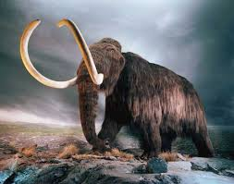
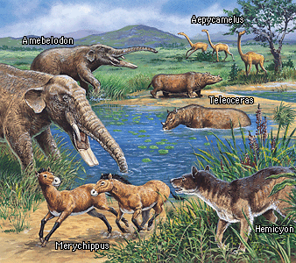
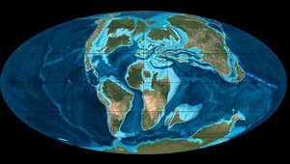
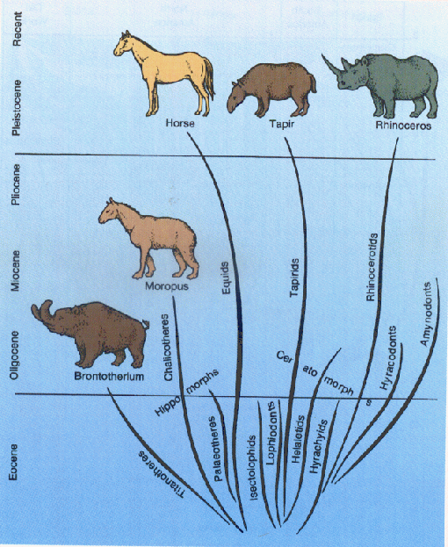
Events of the Cenozoic Era
Began 65 Million years ago
Continents assumed their current position
Himalayas form when India collides with Eurasia
Climate cooled, forming polar ice caps
Divided into Tertiary and Quaternary
Quaternary characterized by an ice age
Modern humans evolved during late Quaternary

