Slide 1
Volcanic Eruptions

Slide 2
Bell work (3pts)
What is a volcanic eruption?
What is magma?
What is rock made of?

Slide 3
Bell work answers
A volcanic eruption is an outpouring of magma, ash, and/or tephra through an opening in the Earth’s surface.
Magma is melted rock.
Rocks are made of minerals.

Slide 4
Group Discussion
Q:What makes the eruption of one volcano quiet, and the eruption of another explosively violent?

Slide 5
A volcano’s explosivity depends on the composition of the magma. In general, as the amount of gases in magma increases, the explosivity increases. Also, the more viscous the magma is, the more explosive it will be.

Slide 6
Viscosity
The physical property that describes a material's resistance to flow. For example, honey has a high viscosity because it is thick and resists flowing. When lava is very viscous, the gas cannot escape as readily and so they form gas bubbles that escape violently.
Magma with high silica content tend to be thick and sticky.

Slide 7
Videos
https://www.youtube.com/watch?v=gRdP9_v3USU
https://www.youtube.com/watch?v=2iaqE0xmsHI

Slide 8
Types of Magma
Basaltic Magma
Andesitic Magma
Rhyolitic Magma

Slide 9
Basaltic Magma
-When rock in the upper mantle melts, basaltic magma typically forms
-Low silica content- flows freely
-Erupts nonexplosively
Ex’s- Mauna Loa and Kilauea actively produce basaltic magma.

Slide 10
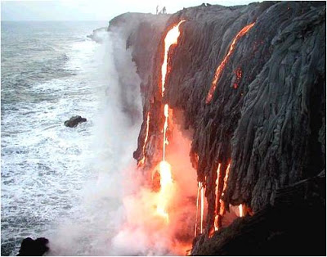
Basaltic Magma
Pinto, B. H. (1970, January 01). Brhectorsgeoworld. Retrieved February 23, 2018, from http://brhectorsgeoworld.blogspot.com/2009/05/volcano.html
Moves at a fast pace

Slide 11
Andesitic Magma (an duh SIH tihk)
-Contains 50 to 60 percent silica
- Found along oceanic-continental subduction zones
-Erupts explosively
Ex’s- Colima Volcano in Mexico and Tambora in Indonesia

Slide 12
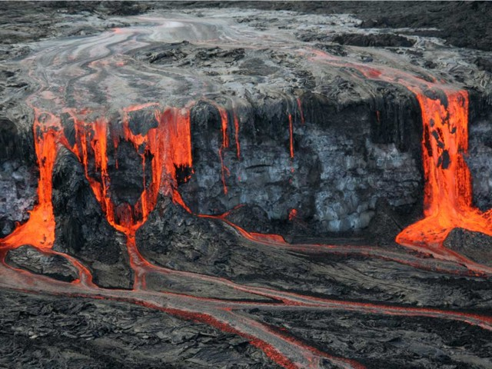
Andesitic Magma
Moves at a medium pace.

Slide 13
Rhyolitic Magma
-Has the same composition as the rock granite
-More than 60 percent silica
-Source material is the continental crust
-Very explosive
Ex’s- dormant volcanoes in Yellowstone National Park

Slide 14
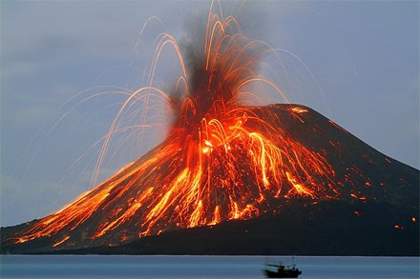
Most explosive
Moves slowly

Slide 15
Tephra
Term used to describe rock fragments and other solid materials ejected from a volcano.
Includes ash, blocks, bombs, and lapilli (pyroclastic material)

Slide 16
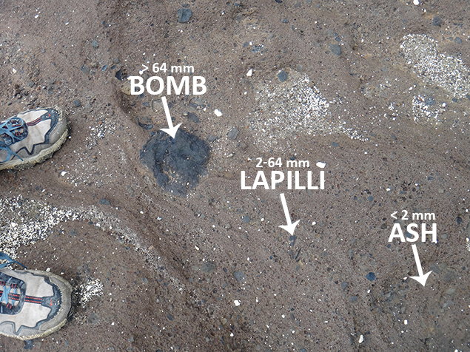

Slide 17
Pluton
A pluton is a body of intrusive igneous rock (called a plutonic rock) that is crystallized from magma slowly cooling below the surface of the Earth. Plutons include batholiths, stocks, dikes, sills, laccoliths, lopoliths, and other igneous formations.

Slide 18
Batholiths
The largest plutons are called batholiths. Batholiths are irregularly shaped masses of coarse grained igneous rock that take millions of years to form.

Slide 19
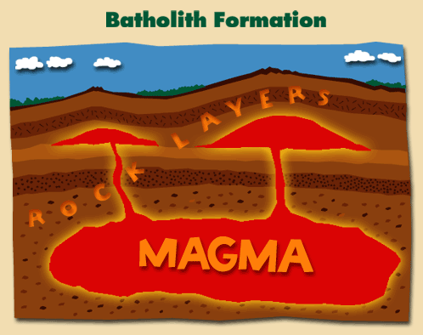

Slide 20
Stocks
Irregulalrly shaped plutons that are similar to batholiths but smaller in size

Slide 21
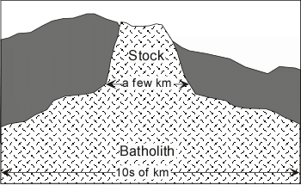

Slide 22
Laccolith

Slide 23
Sills
Sill, also called sheet, flat intrusion of igneous rock that forms between preexisting layers of rock.

Slide 24
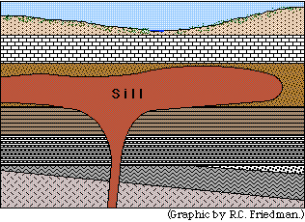

Slide 25
Dike
A pluton that cuts across preexisting rocks. Dikes often form when magma invades cracks in surrounding rock bodies. Dikes range in size from a few centimeters to several meters wide.

Slide 26
Volcanic Cone
A volcanic cone is a triangle-shaped hill formed as material from volcanic eruptions piles up around the volcanic vent, or opening in Earth's crust. Most volcanic cones have one volcanic crater, or central depression, at the top.

Slide 27
